Slide 1

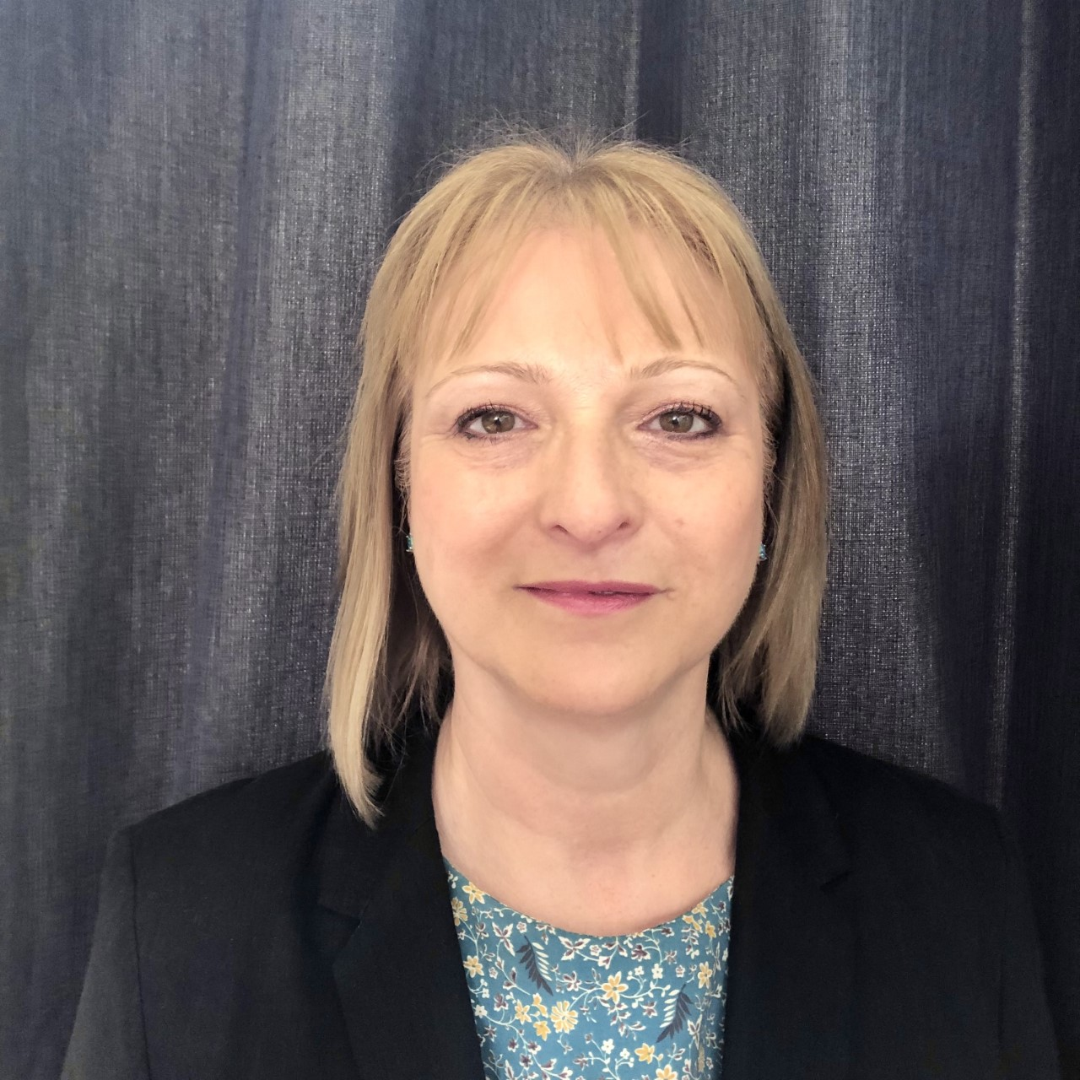
Neurodiversity in the Workplace
Christine Frame BA (Hons), MA, MCIPD
christine.frame@nhs.net
Mobile: 07732 406537
Notes:
3.7% of the NHS workforce have declared they have a disability on ESR. That is only the tip of the iceberg.
No one will be asked to share if they have, or suspect they have, a neurodiversity.
However, I do have Dyslexia and ADHD so I can talk with some experience. I left school at 15 with no qualifications. School was horrendous as it was for many of us in the 1970s and I was in the dunces stream, destined for the factory floor. I worked in various dead end jobs and then into telesales and specifically selling computers and printers in the late 1980s. I was pretty good at sales and did well but after being made redundant yet again in 2002, I decided to change direction. I got into university and that’s when I found out I had dyslexia. I graduated with a 2:1 in Human Resources Management and went on to do a self funded Masters. I’ve worked in training and gained a few diploma’s along the way including coaching diploma. Last year, at the age of 57, I was diagnosed with ADHD. After working in HR for the NHS since 2008, I am currently on secondment working as a Business Change Analysist for the K&M Pathology Network and I love it.
Let’s get started - What neurodiverse conditions can you name?

Slide 2
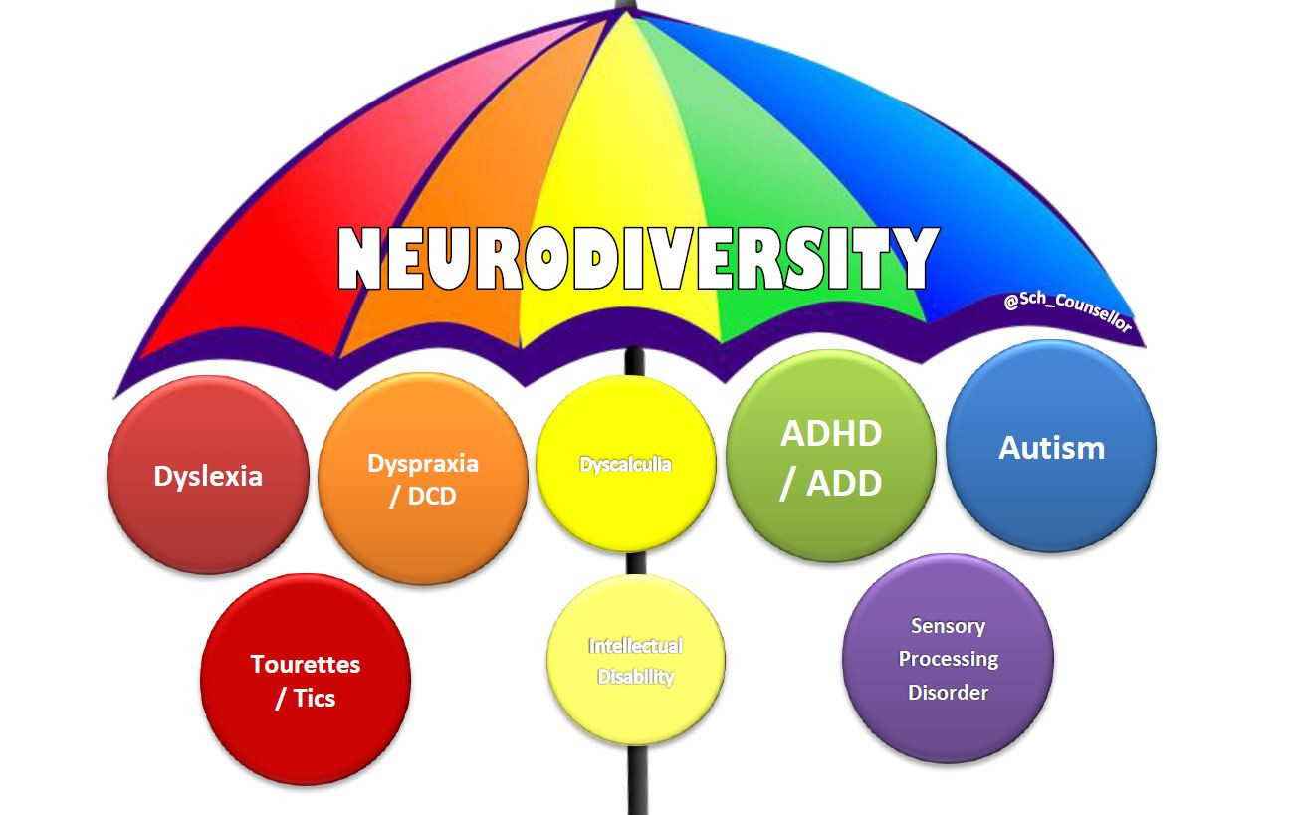


What is Neurodiversity?
Kent and Medway Pathology Network

Slide 3
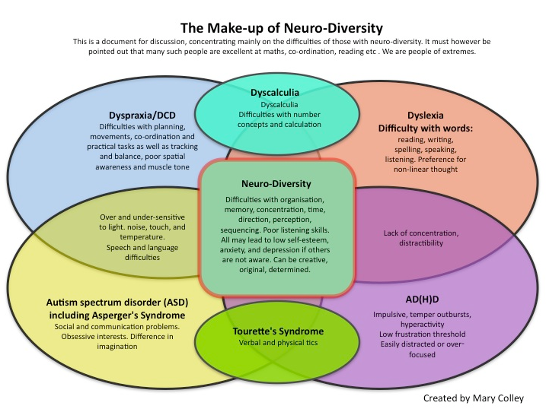
Common types of neurodiversity
What do you think of this slide?
Notes:
Q - WHAT DO YOU THINK OF THIS SLIDE?
A - It’s all negative, focuses on the problems and negative behaviours.

Slide 4
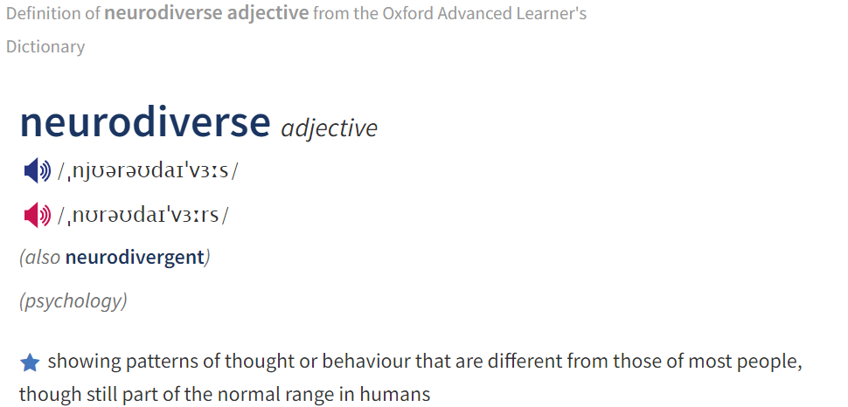
Neurodiversity
Kent and Medway Pathology Network
Look for problems and what people can’t do
Forget what people can do
Easy to stereotype people and put into boxes
Assume people are abnormal, don’t fit the norm
Need a diagnosis and will be ‘normal’ with treatment
Neurodiversity = (see Oxford English Dictionary definition)
Neurodiverse people interpret, think, process & feel differently from neurotypical people
Notes:
We are now going to look in more details at some of the most common learning difficulties, notice I said difficulties and not disabilities. For each condition I’ll start with the symptoms, which can look like negatives and then go onto the positives. Because those of us who see the world differently brings lots of benefits to tackling the challenges in the modern workplace.

Slide 5
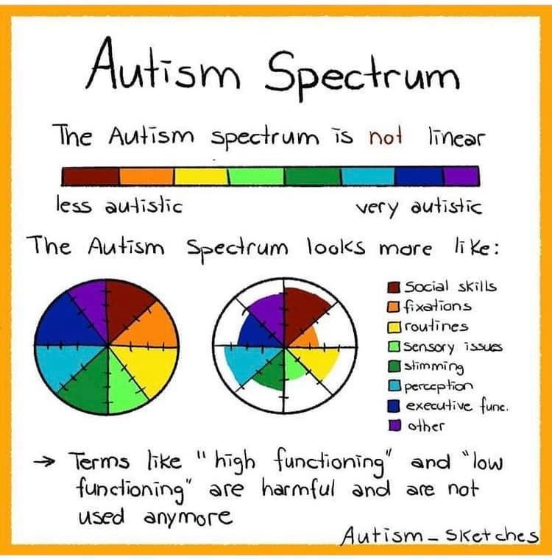
Autism
Kent and Medway Pathology Network
What is autism?
Characterised by repetitive patterns of behaviour, difficulties with social communication. Struggle with change and other people’s point of view.
Challenges
Speech
Sensitivity to light, sound & touch
Perception of others emotions
Information processing
Multi-tasking
Tasks not interested in
Strengths
Logical thinking
Attention to detail
Efficiency – following rules & sequences
Retention of knowledge
Mathematical & technical abilities
Honesty & loyalty
www.autism.org.uk
Notes:
Autism Spectrum - affects people in different ways. Social & Communication problems you might see are; they take things literally and don’t get abstract concepts. They need extra time to process information or answer questions. They have difficulties reading other people and may appear to be insensitive or rude. They may appear to behave 'strangely' or in a way thought to be socially inappropriate, such as rocking, strimming/humming and find it hard to form friendships. They may be very overwhelmed by noise, light, smell or by touch. They like to have routines so that they know what is going to happen. Changes to their routine can also be very distressing for autistic people and make them very anxious.
Autistic people may display a range of strengths and abilities that can be directly related to their diagnosis, including: Memorising and learning information quickly. Thinking and learning in a visual way. Logical thinking ability. May excel (if able) in academic areas such as science, engineering and mathematics as they are technical and logical subjects that do not heavily rely on social interaction. Having an extraordinarily good memory (being able to remember facts for a long period of time). Being precise and detail orientated. Exceptional honesty and reliability. Being dependable in regards to schedules and routines. Having an excellent sense of direction. Be very punctual.
Strong adherence to rules. Able to concentrate for long periods of time when motivated. A drive for perfection and order. A capability for alternate problem solving.
A rare freshness and sense of wonderment.

Slide 6
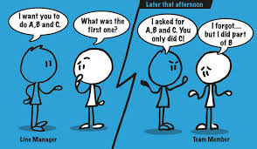
Dyslexia
Kent and Medway Pathology Network
What is dyslexia?
Affects the skills involved in accurate & fluent word reading & spelling. Can include challenges with information processing, short-term memory & timekeeping. Due to altered brain function, not a deficiency in language, word processing or motor-control.
Challenges
Memory
Organisation
Writing
Reading
Time Management
Strengths
Creativity
Problem Solving
Design & spatial awareness
Communication
Ability to see the bigger picture
www.bdadyslexia.org.uk
The Advantages of Dyslexia – Junior Learning USA
Notes:
Dyslexia - Confuse visually similar words such as cat and cot, poor or erratic spelling, read/write slowly, need to re-read paragraphs to understand them. Find it hard to listen and maintain focus and concentrate if there are distractions. Have difficulty telling left from right, get confused when given several instructions at once, have difficulty organising thoughts on paper, often forget conversations or important dates, have difficulty with personal organisation, time management and prioritising tasks, Avoid certain types of work. When they feel sensations of mental overload/switching off. www.bdadyslexia.org.uk
Strengths
UK research shows that 35% of US entrepreneurs and 20% of UK Entrepreneurs are dyslexic. Everatt's (1999) study also found that dyslexic adults showed signs of greater creativity, along with a more innovative problem-solving style approach.
Harvard University compared the abilities of college students with and without dyslexia for memorizing blurry-looking images resembling x-rays. Again, those with dyslexia showed an advantage over non-dyslexic students, benefiting those in the fields of science or medicine. For the most part, dyslexics aren't subsequent thinkers that move chronologically from one idea to the next, but they thrive in a simultaneous thinking environment where ideas are connected via different routes. By seeing things more holistically, this helps them to quickly identify missing components to complete the broader puzzles. Dyslexics have a great ability to sense, understand, and respond (emotionally and practically) to how people feel. This is because they are naturally visual-spatial learners and cannot automatically rely on text and sound for information. As a result, they tend to develop remarkable visual and intuitive abilities, including reading body language and facial expressions. The Advantages of Dyslexia – Junior Learning USA

Slide 7
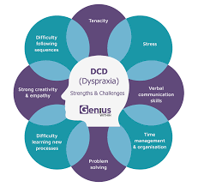
Dyspraxia/Developmental
Co-ordination Disorder
Kent and Medway Pathology Network
What is dyspraxia/DCD?
Affects co-ordination, movement, balance & organisational abilities e.g. hand to eye co-ordination and spatial awareness.
Challenges
Hand-eye co-ordination
Spatial awareness
Organisation & planning
Interpreting non-verbal communication
Short-term memory
Expressing thoughts clearly
Strengths
Empathy
Leadership
Strategy
Problem solving
Hardworking/tenacity
Attention to detail
www.exceptionalindividuals.com
Notes:
Dyspraxia also known as developmental co-ordination disorder (DCD), is a common disorder that affects movement and co-ordination. A person with dyspraxia may find it difficult to coordinate their body movements and themselves in general including work. They may be labelled as clumsy. They can find it difficult to plan what to do, and how to do it. May have problems with understanding non-verbal skills, and have unclear speech and jumbled word order. They can have difficulty distinguishing sounds from background noise and also may be extremely sensitive to taste, light, touch, and/or noise. There may also be a lack of awareness of potential dangers. Many experience moods swings and display erratic behaviour. They can have poor posture and fatigue. Writing and drawing are difficult. Grooming and dressing can be challenging such as – shaving, applying makeup, fastening clothes, tying shoelaces. Poor hand-eye coordination.
Strengths
They tend to have high verbal IQ’s, despite their struggles with organization and language structure. Attention to detail is common as they look at the world from “outside the box” and must work to make others understand their perspective. They are highly sensitive and empathetic to others; they know what it means to live with a hidden disorder that can impact all areas of life. They also tend to be driven to succeed, and have a work ethic to match their determination. Individuals with dyspraxia often have a high level of creativity, strategic thinking, leadership and problem-solving skills. They may also be very good at visual tasks and have strong attention to detail. www.exceptionalindividuals.com

Slide 8
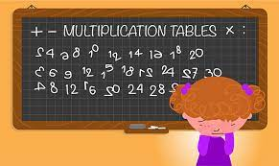
Dyscalculia
Kent and Medway Pathology Network
What is dyspraxia/DCD
Dyscalculia is a learning disability that makes maths challenging to process and understand. Symptoms range from difficulty with counting and basic mental math to trouble with telling time and direction
Challenges
Processing numbers and quantities
Recalling maths facts and formulas
Difficulty linking numbers to symbols and seeing patterns
Telling time using an analogue clock
Estimating quantities and making sense of money
Poor visual and spatial orientation
Strengths
Creativity & imagination
Strategic thinking
Practical ability
Problem solving
Good at reading, writing and spelling
Intuitive thinking
www.idlsgroup.com/news/strengths-of-dyscalculia
Notes:
Dyscalculia is a specific and persistent difficulty with processing numbers and quantities, including: Trouble with mental maths and problem-solving, recognising quantities without counting, recalling basic maths facts (like multiplication tables), Difficulty linking numbers and symbols to amounts, making sense of money and estimating quantities, telling time on an analogue clock, Poor visual and spatial orientation, Difficulty immediately sorting out direction (right from left), Troubles with recognizing patterns and sequencing numbers.
Strengths Creativity – a lot of people with dyscalculia are very artistic and have above average imaginative skills, which is reflected in their learning style.
Strategic thinking – people with dyscalculia see situations holistically, enabling them to identify the important elements and not just focus on one element or the minor details. Practical ability – people with dyscalculia are very hands on and practical, which is a great to skill to have and can lead to some very exciting careers. Problem Solving – people with dyscalculia are fast problem solvers, have the ability to think outside of the box and can reflect on past experiences. This provides unique insight and methods for solving problems. Love of words – people with dyscalculia are often exceptional at reading, writing and spelling.
Intuitive thinking – people with dyscalculia are good at interpreting reality and processing knowledge, experiences and signs around them. Albert Einstein, who had learning difficulties, said that his studies relied a lot on intuition.

Slide 9
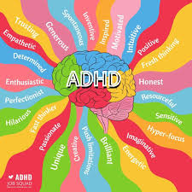
ADHD
Kent and Medway Pathology Network
What is ADHD?
Attention deficit hyperactivity disorder (ADHD) is a condition that affects people's behaviour. People with ADHD can seem restless, may have trouble concentrating and may act on impulse. (NHS)
Challenges
Attention to detail
Competing tasks & following instructions
Organisation & Time management
Restless energy & impatience
Keeping quiet
Mood swings
Strengths
Hyper focussed
Creative
Problem solving
High levels of social intelligence
Empathic
Fun to be around
Communication
What are the benefits of ADHD? (medicalnewstoday.com)
Attention deficit hyperactivity disorder (ADHD) - NHS (www.nhs.uk)
Notes:
ADHD – There are three types of ADHD and there are differences between men and women, but for this slide lets look at the general adult symptoms such as: carelessness and lack of attention to detail, continually starting new tasks before finishing old ones, poor organisational skills and time management, inability to focus or prioritise, continually losing or misplacing things, forgetfulness, restlessness and edginess, difficulty keeping quiet, and speaking out of turn, blurting out responses and often interrupting others, mood swings, irritability and a quick temper, inability to deal with stress, extreme impatience, taking risks in activities, often with little or no regard for personal safety or the safety of others – for example, driving dangerously. (NHS Adult Symptoms)
Strengths
Hyperfocusing is a state where an individual with ADHD can focus on a task for hours on end, essentially tuning out everything around them if the individual is doing a job that they enjoy and find interesting. Those with ADHD are often highly creative, especially when given a goal-oriented task. Living with ADHD also requires people to approach tasks differently, which means they can become great problem solvers. Those with ADHD often think of unusual solutions because of their different perspectives. A recent study highlighted that people with ADHD may have higher levels of social intelligence, humour, and recognition of feeling, or empathy. Some people with ADHD do recognized their own abilities and have a more positive mental approach, and in turn, more “social success.”

Slide 10
How teams can support their neurodivergent colleagues
Kent and Medway Pathology Network
By default, workplaces support neurotypical people
Neurodiversity is often overlooked at work
Neurodivergent people bring strength & diversity to organisations
Neurodiverse people often have to advocate for themselves
Supporting diversity in the workplace has positive benefits for everybody in terms of happiness, productivity and innovation
Scientific careers are attractive to neurodiverse people
1 in 7 people are neurodivergent
One person’s weakness is another person’s superpower
Isn’t the workplace the perfect place to embrace thinking differently – especially with current challenges!
Notes:
We are not neurotypical and never will be. No amount of pills, therapy or reasonable adjustments are going to ‘cure’ us.
It can be hard to ask for help and explain our world. If all your world is blue, how do you describe blue? Afterall, we probably don’t know how you see the world either. Just because we are different doesn’t mean we are wrong. Actually, our unique perspectives bring many benefits to organisations especially in the areas of problem solving, science and medicine. So let’s look at how we can support neurodivergent colleagues.

Slide 11
How can we support our neurodivergent colleagues?
Kent and Medway Pathology Network
Start with an understanding of what neurodiversity is
Don’t expect people to tell you they are neurodiverse – they may not know and/or they may not wish to disclose to you
Openly talk about neurodiversity as part of your normal EDI conversations
Support and respect different ways of working and communicating
9-5 vs early/evening shifts – productivity is key
Identify the best ways of communicating
  Ways of explaining things
  Clear instructions, checking understanding
  Verbal conversations vs emails, spreadsheets etc
Be an ally to others
Be mindful that words are powerful and can hurt other people
Don’t make assumptions and/or judgements about behaviours or the person’s ability to deal with situations or tasks – create psychologically safe space so people feel OK to be open & honest with you.
Notes:
1. Don’t expect the person to wear their diversity label on a t-shirt!
6. Communication - You might need to do a bit of research yourself. Think about your communications style, you might need to cut the background noise such as the whys and wherefores and get straight to the task at hand. Don’t make promises you can’t keep. If plans change – tell them.

Slide 12
What managers can do
Kent and Medway Pathology Network
Understand neurodiversity in the workplace
Look at the potential rather than the problem
Know what resources are available to support colleagues and tell everybody
Normalise conversations about neurodiversity
Help to take the burden off the individuals
Encourage flexible working – to get the best out of people, include sickness absence management
Consider Workplace Adjustments, H&WB Passports, – especially for people when they move departments within the same organisation
Make interviews and applications neurodivergent friendly – e.g. give questions in advance
Be part of the change
Notes:
6. Sickness Absence – The NHS People Plan requires that sickness absence targets are monitored to support those with a disability, therefore, check with your HR department about the possibility of setting a more appropriate and supportive absence management monitoring. One size does not fit all.

Slide 13
Good management
Kent and Medway Pathology Network
Encourage individuals to look ahead and anticipate the problems they might encounter because of their condition especially as they face new challenges.
Separating complicated tasks/instructions/problems into smaller steps. Be clear on exactly what you want to be achieved in what format and by when. Check they have understood by asking them to repeat the instruction.
Offer support during working time to access additional training/support via your Learning & Development Department.
Give them a chance to practice newly learned skills in a safe place. It also involves teaching people with neurological conditions how to recognise and deactivate “stress triggers.”
Give opportunities to display mastery and experience success. Providing these opportunities gives individuals a chance to learn how to replace the language of self-doubt with the language of success.
Encouraged them to use what he or she has learned about minimising and managing stress, and the relationship between stress and dyslexia/dyscalculia/dyspraxia, to plan for a future in which continued success is likely.

Slide 14
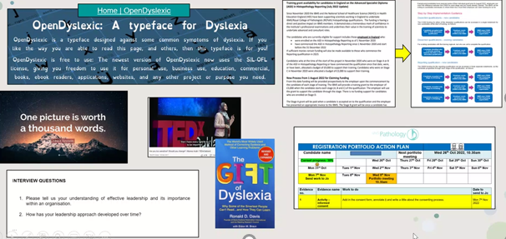
What could you do differently right now?
Kent and Medway Pathology Network
Notes:
There are lots of resources out there to help you.
For interviews, a person with Asperger's may find going to a new place and meeting new people overwhelming. Think of alternatives such as the first interview on line.
Putting complicated or long word documents into a different format that is easier to follow. Use pictures, different fonts and colours codes.
Check and re-check understanding of discussions and meetings. Give clear and concise instructions and check understanding with open ended questions such as, what do you think you might need to achieve this or how might you go about achieving this? Could you just tell me what you think I have just asked for/said so I can check we are on the same page?

Slide 15
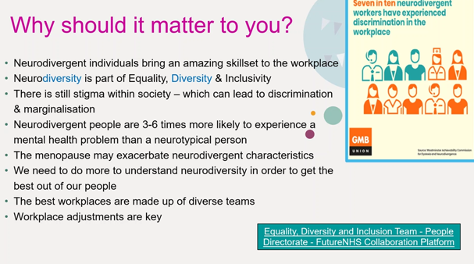

Slide 16
Resources
MTW – Disabled Staff Network MTW Intranet
NHS guidance for staff and managers Work and disability - NHS (www.nhs.uk)
IBMS commitment to ED&I IBMS re-signs Science Council EDI Declaration - Institute of Biomedical Science
Access to Work Access to Work: get support if you have a disability or health condition: What Access to Work is - GOV.UK (www.gov.uk)
Disabled Employee Rights Disability rights: Employment - GOV.UK (www.gov.uk), Disability at work | Acas,
Asking to help with your rights Asking your employer for changes to help you if you’re disabled - Citizens Advice and your Trade Union

Slide 17
Welcome
Kent and Medway Pathology Network
Introductions and Ice breaker
The situation is dire! Following a shipwreck, everyone has been stranded on a deserted island! Each person is allowed to bring one object to the island — ideally something that represents them or something that they enjoy. Doesn’t have to be realistic.

Slide 18
Course Sessions Overview by module
Kent and Medway Pathology Network
What is Neurodiversity?
Employment Law
Leading Neurodiverse Teams
Fair Recruitment & Selection Methods
Making Change Happen

